Slide 1

PRODUCT AND SALES performance ANALYSIS
TDI SAPPHIRE COHORT SQL CAPSTONE 2025
PRESENTED BY FELICITAS EZECHIKELUBA

Slide 2
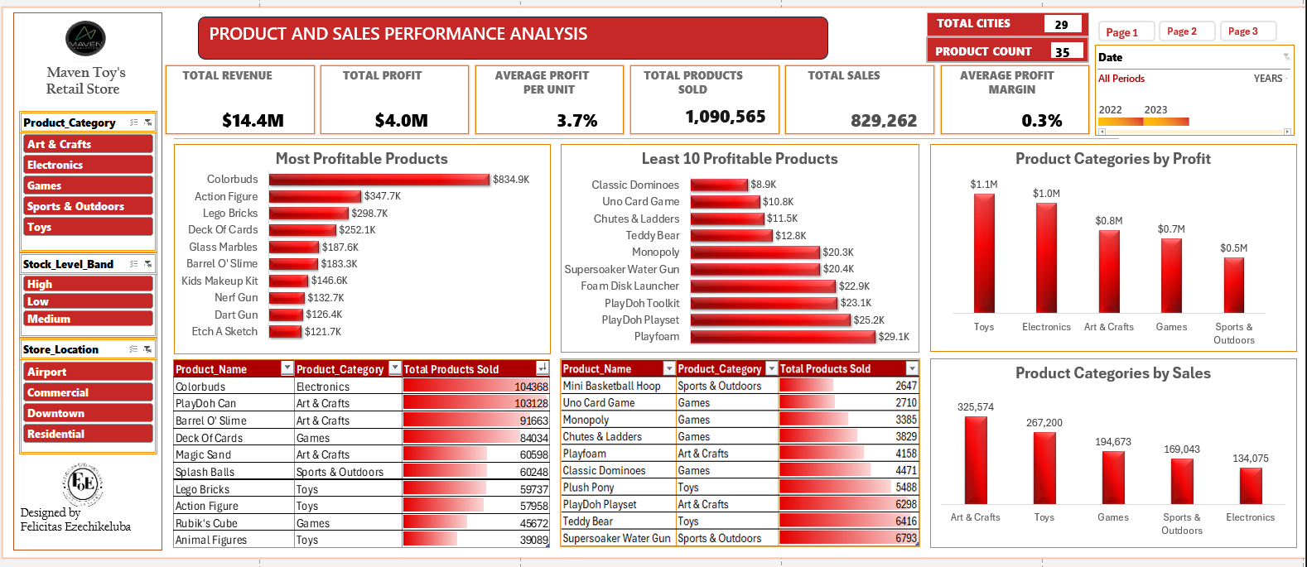

Slide 3
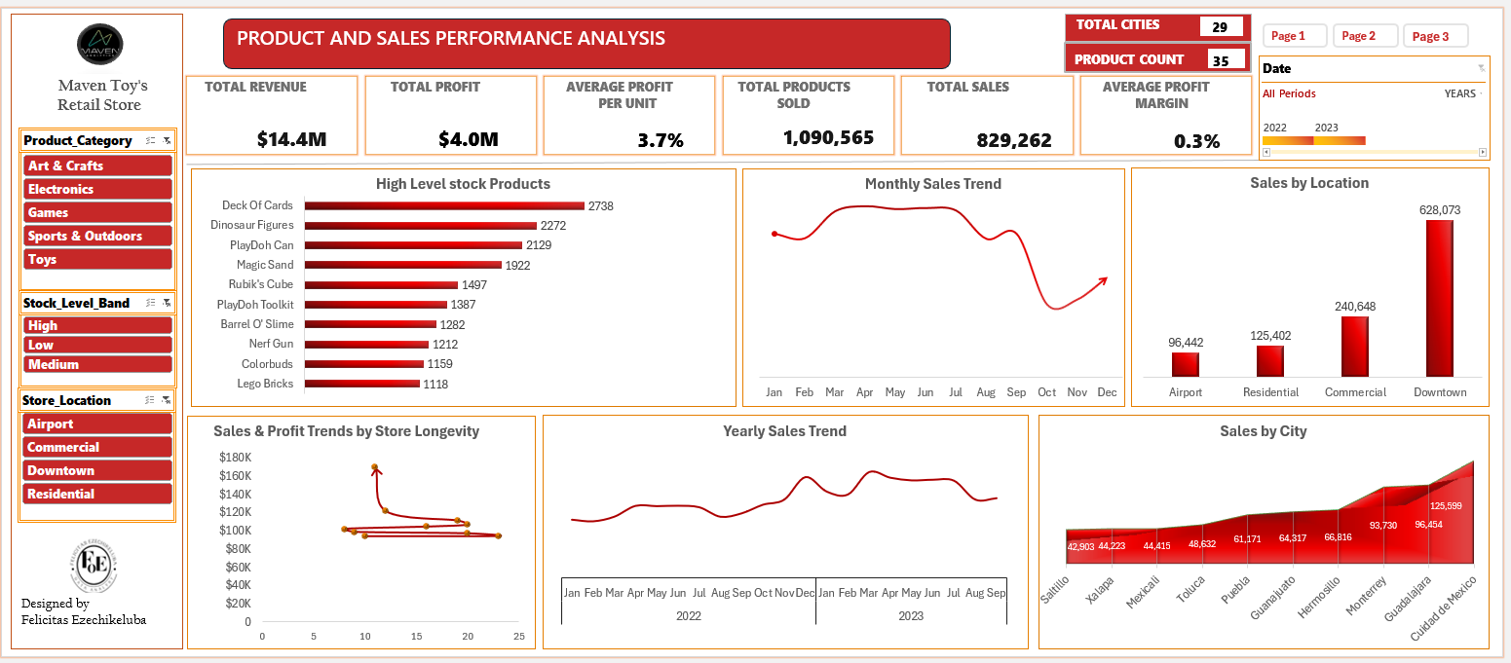

Slide 4
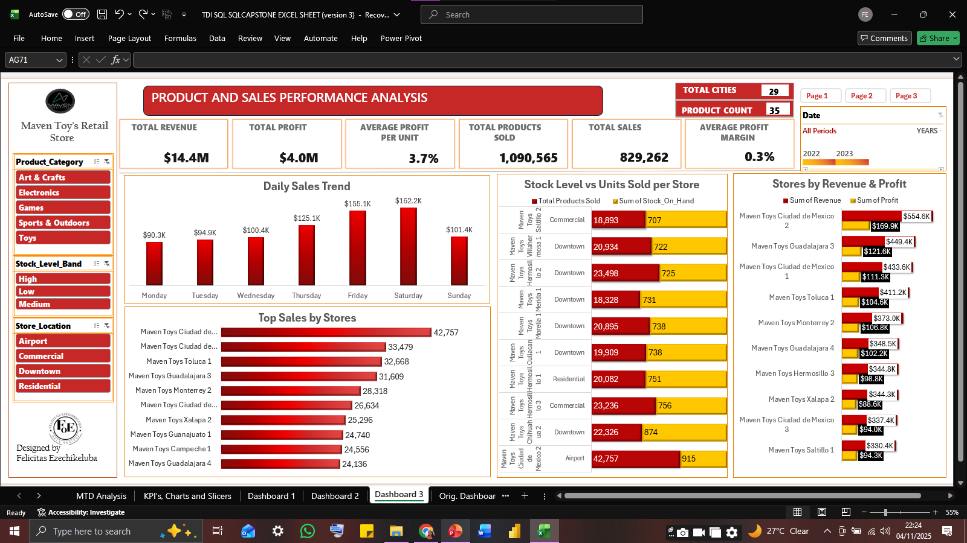

Slide 5
INTRODUCTION
This project analyzes sales, product, inventory, and store data from Maven Toys, a fictional toy retail 4 chain stores operating across 29 Mexican cities. By examining multiple data tables, the analysis uncovers product performance patterns, seasonal demand trends, and the impact of store location and age on sales results. The findings highlight which products are top sellers and which underperform, when most products are sold throughout the year, and how different stores compare . These insights support smarter business decisions in inventory management, pricing strategies, and promotional planning to boost sales and improve overall profitability.

Slide 6
PROBLEM STATEMENT
Ultimately, the goal is to understand: What factors are influencing product and sales performance?

Slide 7
GOALS
By working with multiple tables, I explored product performance, seasonal sales trends, and how store location or age might affect results.
The goal is to give a full picture of what drives sales and how the business can grow more effectively.

Slide 8
OBJECTIVES
•Identify top-selling and underperforming products to improve inventory planning.
•Analyze revenue and profit trends across products, categories, and stores.
•Measure product performance drivers such as price, location, and category.
•Investigate inventory levels to find products that are overstocked or selling slowly.
•Understand how store age, location, and product category influence performance.
•Explore time-based patterns (daily, monthly, seasonal) to guide pricing, stocking, and promotion strategies.

Slide 9
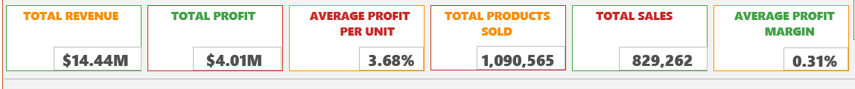
KEY PERFORMANCE INDICATORS
Total Revenue: The total income generated from all product sales.
Total Profit: The overall earnings after subtracting product costs from revenue.
Total Sales (Count): The total number of sales transactions or units sold.
Average Profit per Unit: The average amount of profit earned on each unit sold.
Product Count: The number of distinct products sold by the store.
Total Products Sold: The sum of all units sold across all products.

Slide 10
KEY BUSINESS QUESTIONS
KEY BUSINESS QUESTIONS
Which products and categories drive the highest sales?
Which products and categories drive the lowest sales?
Which Product Categories drive the Most and Least sales?
Which products generate the most profit?
Which products generate the least profit?
Which product categories are most and least profitable?

Slide 11
KEY BUSINESS QUESTIONS
Which months have the highest and lowest product sales?
Which store locations perform best in terms of product sales?
Are certain stores more profitable based on how long they've been open?
Which stores hold the highest stock levels, and are those products selling?
Which stores generate the highest revenue and profit?
Which cities record the highest sales volumes by product?

Slide 12
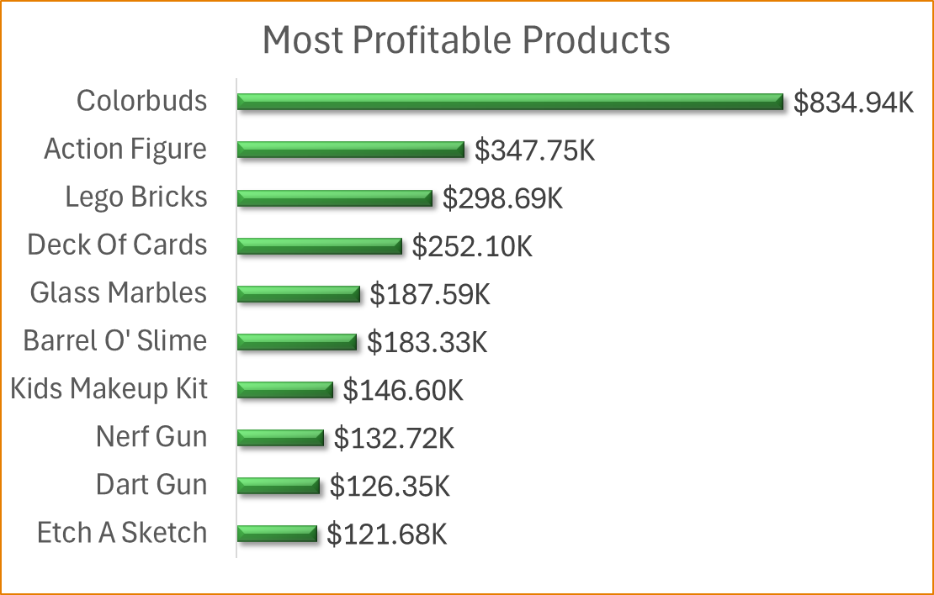
ANALYSIS & FINDINGS
Which products generate the most profit?
Finding:
Colorbuds generates the highest profit: $834.94K , significantly above all others.
Followed by Action Figure ($347.75K) and Lego Bricks ($298.69K).
Other top performers include Deck Of Cards, Glass Marbles, and Barrel O' Slime.
Insight:
Colorbuds stands out with exceptional profitability , suggesting high unit margin or volume.
Toys like Action Figures and Lego Bricks deliver strong returns, reinforcing Toys as a high-value category.
Some lower-cost items (Deck Of Cards, Glass Marbles) still drive solid profit - possibly due to high turnover.
Profit leaders align closely with top-selling products, indicating healthy pricing strategies and demand.

Slide 13
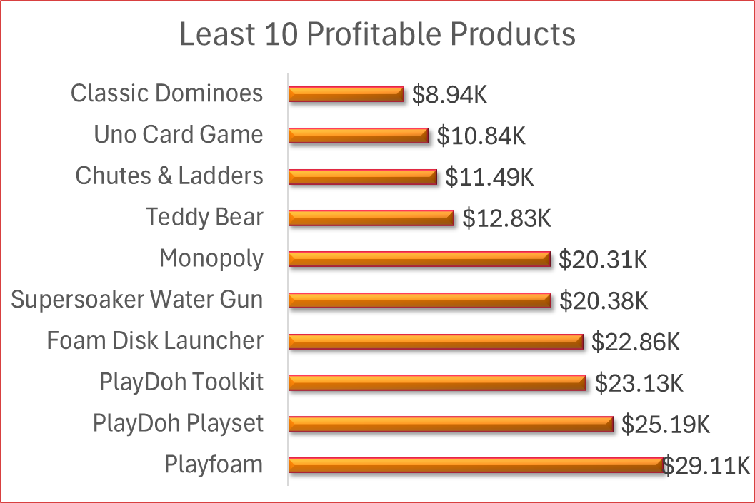
ANALYSIS & FINDINGS
Which products generate the least profit?
Finding:
• Classic Dominoes has the lowest profit at $8.94K.
• Other low-profit items include Uno Card Game, Chutes & Ladders, Teddy Bear, and Monopoly.
• Even popular games and toys like PlayDoh Playset, Foam Disk Launcher, and Playfoam fall in the least profits list.
Insight:
• Many low-profit products are board games or simple toys, suggesting low margins or limited demand.
• PlayDoh variants show up frequently — may indicate over-saturation or weak pricing power in that line.
• Products with low unit price or niche appeal may struggle to generate significant profits despite presence.

Slide 14
ANALYSIS & FINDINGS
Which products and categories drive the highest sales?
Finding:
• Colorbuds (Electronics) is the top-selling product.
• Art & Crafts dominates with 3 products in the top 5.
• Toys appear frequently but don't lead in volume.
• Games and Sports & Outdoors show solid but mid-range sales.
Insight:
• Art & Crafts products (PlayDoh, Slime, Magic Sand) appear multiple times in the top 10, showing this category is very popular. Consider expanding this category with more products.
• Electronics (Colorbuds) is the #1 best-selling product by units sold. Since it already sells well, you can increase profits by selling it together with other items or offering special deals.
• Toys appear several times in the top 10, showing they are a strong category that drives high sales volume.
• Games show mixed results - some perform well while others don't. Performance depends on which specific product it is. Focus marketing efforts on the games that sell best.

Slide 15
ANALYSIS & FINDINGS
Which products and categories drive the lowest sales?
Finding:
• Mini Basketball Hoop (Sports & Outdoors) is the worst-selling product.
• Games make up most of the bottom 10, with 4 entries (Uno, Monopoly, Chutes & Ladders, Dominoes).
• Toys (Plush Pony, Teddy Bear) and Art & Crafts (Playfoam, PlayDoh Playset) also appear but less often.
Insights:
• Games category struggles overall, with many titles in the bottom 10. This suggests customers aren't interested in these specific games, or there's too much stock. Review which games to keep and consider bringing in new ones.
• Some products like Mini Basketball Hoop and Uno Card Game don't attract customers. Consider removing them or change their marketing.
• Toys and Art & Crafts each have both top sellers and poor sellers. Focus on understanding why some items in these categories succeed while others fail, then apply those lessons.
• Low sales might be caused by poor shelf placement, wrong pricing, or stock problems - not just lack of interest. Investigate these factors before deciding to remove products.

Slide 16
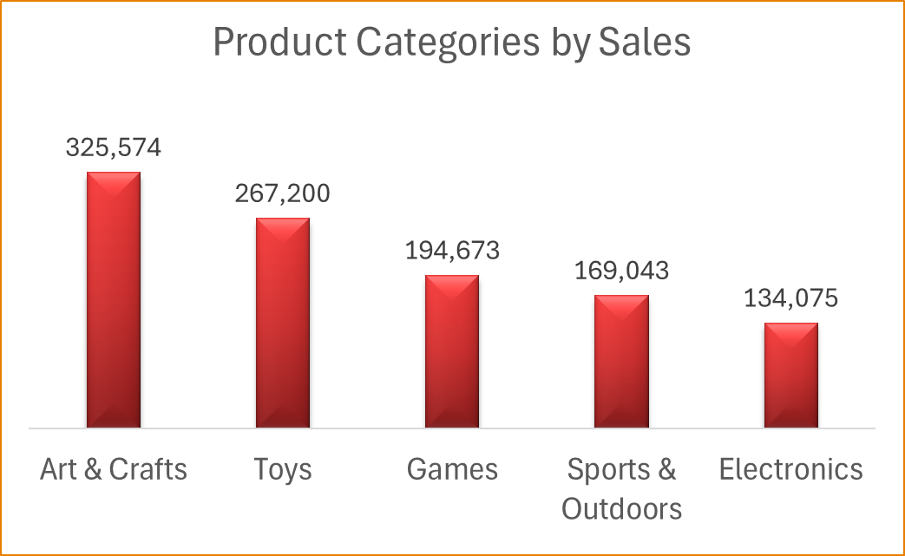
ANALYSIS & FINDINGS
Which Product Categories drive the Most and Least sales?
Finding:
Art & Crafts leads with the highest total sales: 325,574 units.
Followed by Toys: 267,200 units.
Games: 194,673 units.
Sports & Outdoors: 169,043 units.
Electronics records the lowest: 134,075 units.
Insight:
• Art & Crafts is the top-performing category; likely due to multiple popular items driving sustained sales.
• Toys remain a strong core category with broad appeal.
• Electronics, despite Colorbuds' individual success, underperforms as a category ; suggesting limited product range.
• Sports & Outdoors also trails ; may need product diversification or better marketing.

Slide 17
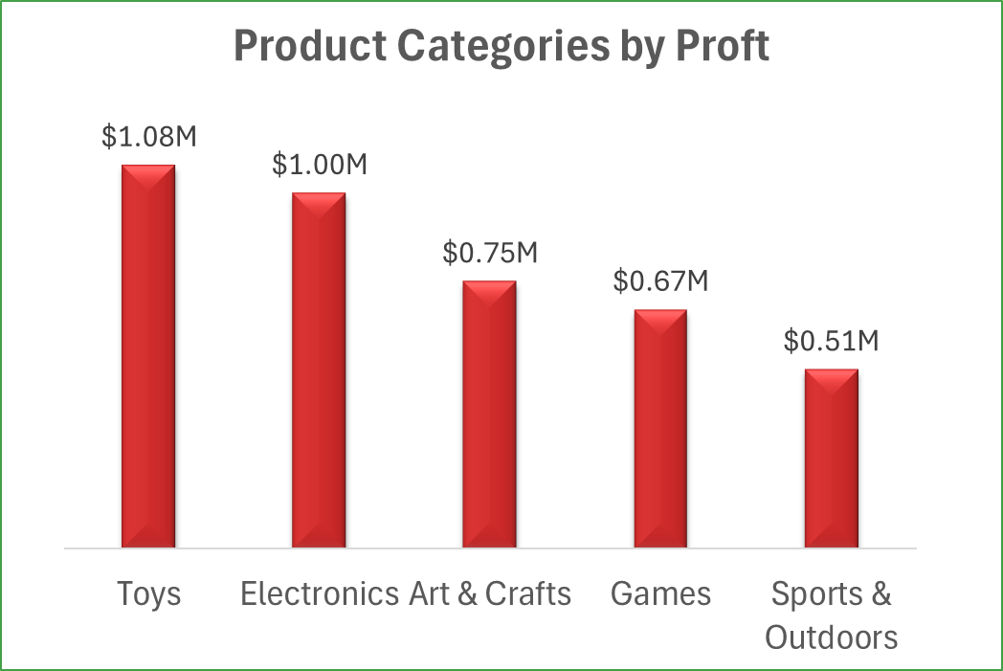
ANALYSIS & FINDINGS
Which products generate the least profit?
Finding:
• Toys led with the highest total profit at $1.08M.
• Electronics follow closely with $1.00M, driven largely by top-performing products like Colorbuds.
• Art & Crafts and Games generate moderate profits at $0.75M and $0.67M, respectively.
• Sports & Outdoors has the lowest profit at $0.51M.
Insight:
• Toys are consistently strong performers in both sales and profitability, a dependable revenue driver.
• Electronics, though least in number of sales, deliver high margins, suggesting strong potential if more products are added.
• Art & Crafts and Games contribute reliably but may benefit from strategic product selection.
• Sports & Outdoors may need attention, either through marketing, pricing adjustments, or product refresh.
.

Slide 18
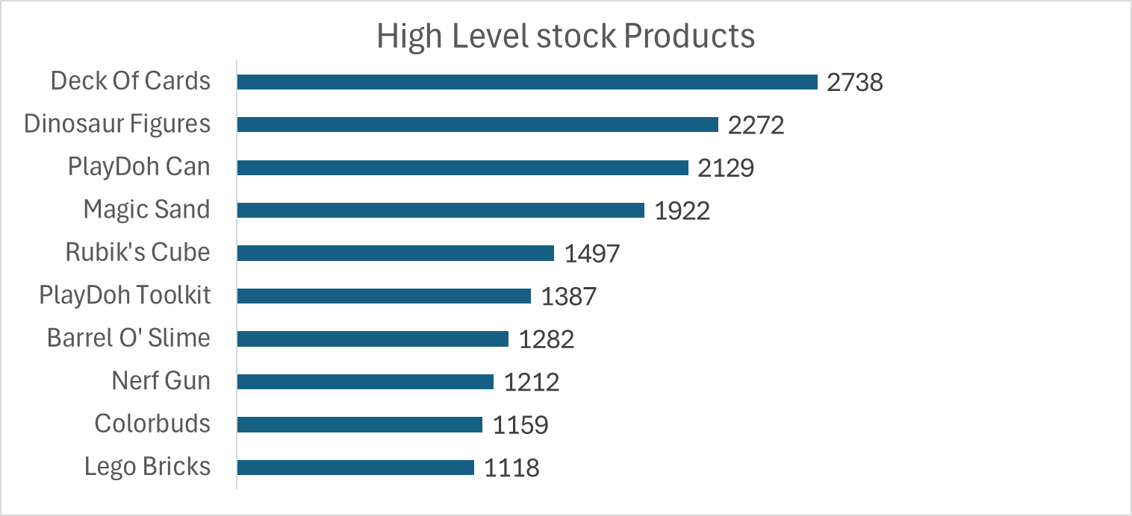
ANALYSIS & FINDINGS
Which products remain in inventory the longest?
Finding:
Deck Of Cards has the highest stock on hand with 2,738 units, followed by Dinosaur Figures (2,272) and PlayDoh Can (2,129).
Other products with high inventory include Magic Sand (1,922) and Rubik's Cube (1,497).
Insight:
Insights:
High stock levels suggest these products aren't selling as fast as expected, inventory isn't rotating properly, or the data was recorded at a specific time.
Even popular products like Deck Of Cards and PlayDoh Can show high inventory. This could mean demand changes by season, or too much stock was ordered at the wrong time.
The company should review stock levels and study when customers actually buy these products. This will help order the right amounts and avoid having too much inventory sitting unsold.

Slide 19
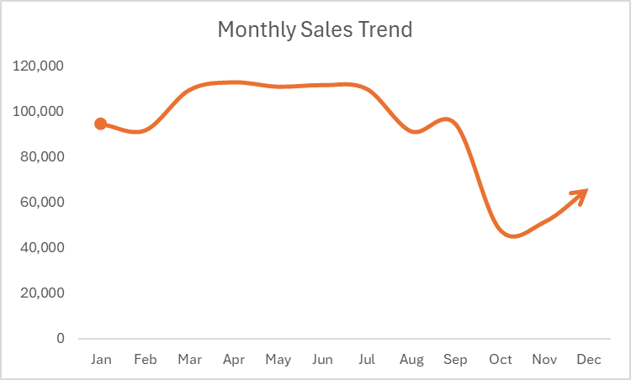
ANALYSIS & FINDINGS
Which months have the highest and lowest product sales?
Finding:
• April (112,695), June (111,453), and May (110,761) are the top three months for product sales.
• October (47,861), November (51,185), and December (66,031) record the lowest monthly sales.
Insight:
• Q2 (April-June) is peak sales season - Launch new products, run major campaigns, and stock heavily to maximize revenue.
• October has the biggest sales drop - Families are saving after back-to-school spending and waiting for Christmas deals. Run mid-October promotions or bundle deals to boost sales.
• November-December underperform despite being holiday months - May indicate incomplete data, stock shortages, or competition. Ensure heavy inventory and strong promotions for future holiday seasons.
• February and August show weak sales - Use these slow months for clearance sales to clear old inventory.

Slide 20
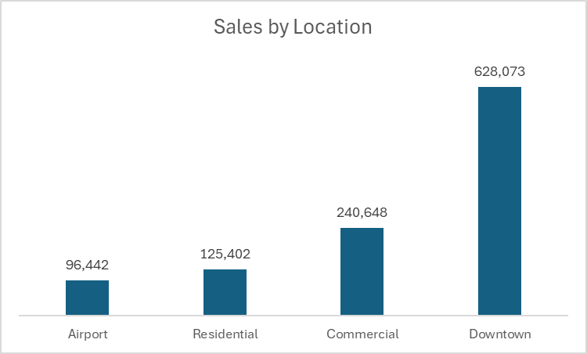
ANALYSIS & FINDINGS
Which store locations perform best in terms of product sales?
Finding:
Downtown stores lead significantly with 628,073 products sold.
Commercial areas follow at 240,648, then Residential (125,402), and Airport (96,442) locations.
Insight:
Downtown locations are the primary sales drivers, likely due to high traffic, accessibility, or tourist presence.
Airport and Residential locations underperform comparatively, may benefit from tailored promotions or optimized product selection.
Consider expanding operations or marketing efforts in Downtown and Commercial zones to leverage existing momentum.

Slide 21
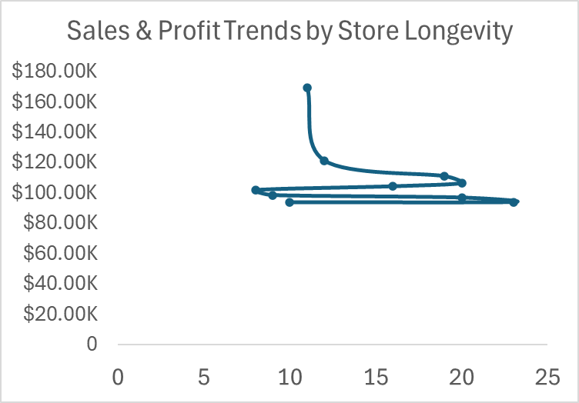
ANALYSIS & FINDINGS
Are certain stores more profitable based on how long they've been open?
Finding:
  Maven Toys Ciudad de Mexico 2: Highest profit ($169.86K, 11 years).
  Saltillo 1 (23 years) & Mexicali 1 (20 years): Moderate profits ($94.25K, $97.21K).
  Guadalajara 3 ($121.57K, 12 years) & Ciudad de Mexico 1 ($111.30K, 19 years): Strong profits.
Insights
  Newer stores (e.g., Ciudad de Mexico 2) can outperform older ones; longevity ≠ high profit.
  Location/market potential drives profitability more than store age.
  Older, low-profit stores need audits, marketing refresh, or product strategy updates.
  Share best practices from high-performing stores to boost others.

Slide 22
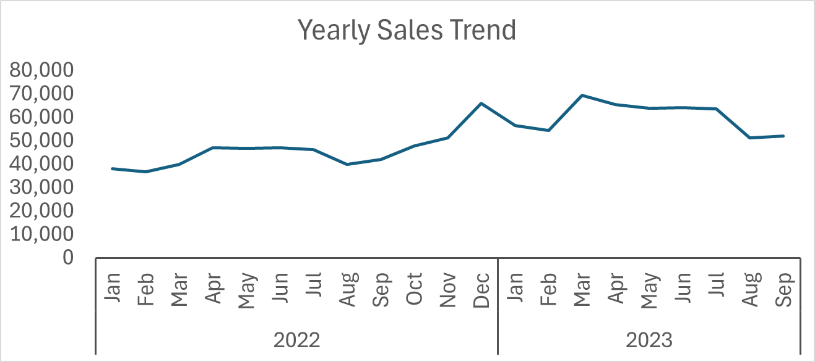
ANALYSIS & FINDINGS
What are the monthly and seasonal sales trends?
Findings
  December peaks at 66,031 units (2022), driven by holiday shopping.
  Sales rise Feb–Jun, peaking in June (64,275 units in 2023).
  Jul–Sep dips slightly but stays steady.
  Q1 2023 (e.g., March: 69,336) outperforms Q1 2022 (March: 39,981).
Insights
  Nov–Dec: Strongest for promotions and stock ramp-up.
  Q2 (Apr–Jun): Ideal for back-to-school campaigns.
  2023 shows growth, reflecting better brand reach.
  Early Q1 & late Q3: Off-peak, perfect for clearance sales. strategies.

Slide 23
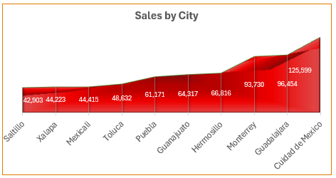
ANALYSIS & FINDINGS
Which cities record the highest sales volumes by product?
Finding:
  Top Cities: Ciudad de Mexico (125,589 units), Guadalajara (96,454 units), Monterrey (93,730 units).
  Lowest Sales: Saltillo (42,903 units), Xalapa (44,223 units), Mexicali (44,415 units).
  Insights
  Ciudad de Mexico, Guadalajara, and Monterrey are top markets - Prioritize inventory, premium product launches, and exclusive promotions in these high-performing cities.
  Saltillo underperforms significantly - Investigate poor store location, weak demand, or marketing issues. Consider store optimization or reassessment.
  Xalapa and Mexicali lag - Evaluate if product mix matches local preferences and if stores need better visibility or marketing.
  Focus resources on top three cities while developing strategies to improve underperforming locations.

Slide 24
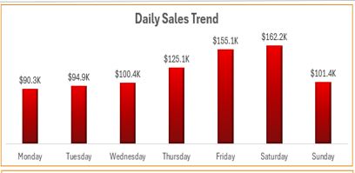
ANALYSIS & FINDINGS
Which days of the week record the highest number of transactions?
Finding:
Saturday ($162.16K) and Friday ($155.09K) generate the highest sales.
Monday ($90.33K) and Tuesday ($94.90K) have the lowest sales.
Insight:
Weekend (Fri–Sun) drives strong sales, peaking on Saturday, ideal for promotions, launches, or peak staffing.
Midweek (Wed–Thu) sees moderate performance, with Thursday ($125.05K) as a standout.
Early week sales (Mon–Tues) are weaker, consider flash deals or marketing nudges to lift activity.

Slide 25
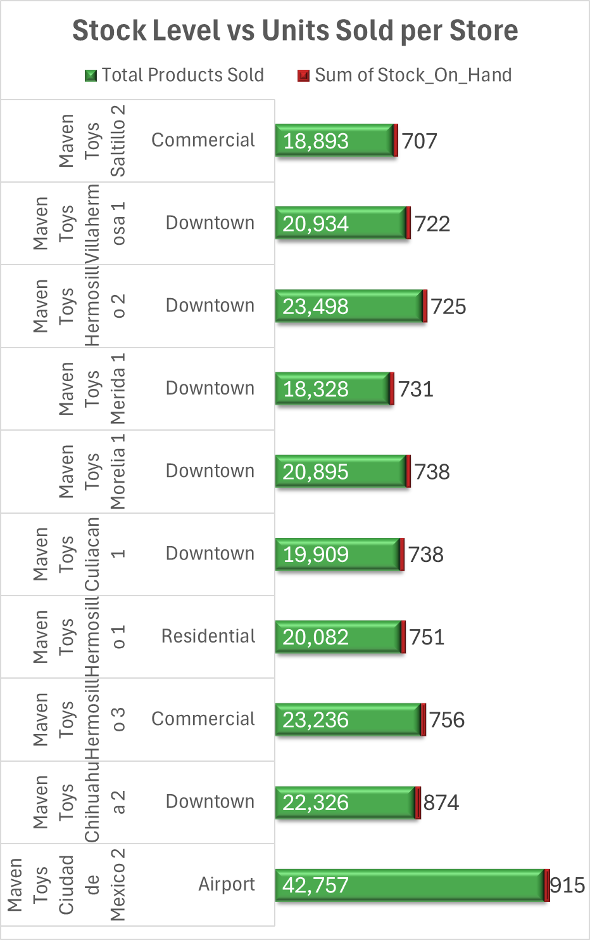
ANALYSIS & FINDINGS
Which stores hold the highest stock levels, and are those products selling?
Finding:
  Maven Toys Ciudad de Mexico 2: Highest stock (915 units) and sales (42,757 units).
  Chihuahua 2 (874 units) & Hermosillo 3 (756 units): High stock, sales ~22–23K units.
  Stores with high stock generally have strong sales and good inventory turnover.
Insights
  High stock levels align with top sales, avoiding idle inventory.
  Ciudad de Mexico 2 excels in balancing high stock with strong sales.
  Predicting customer demand and tracking store traffic ensures products sell quickly and inventory doesn't sit unused.

Slide 26
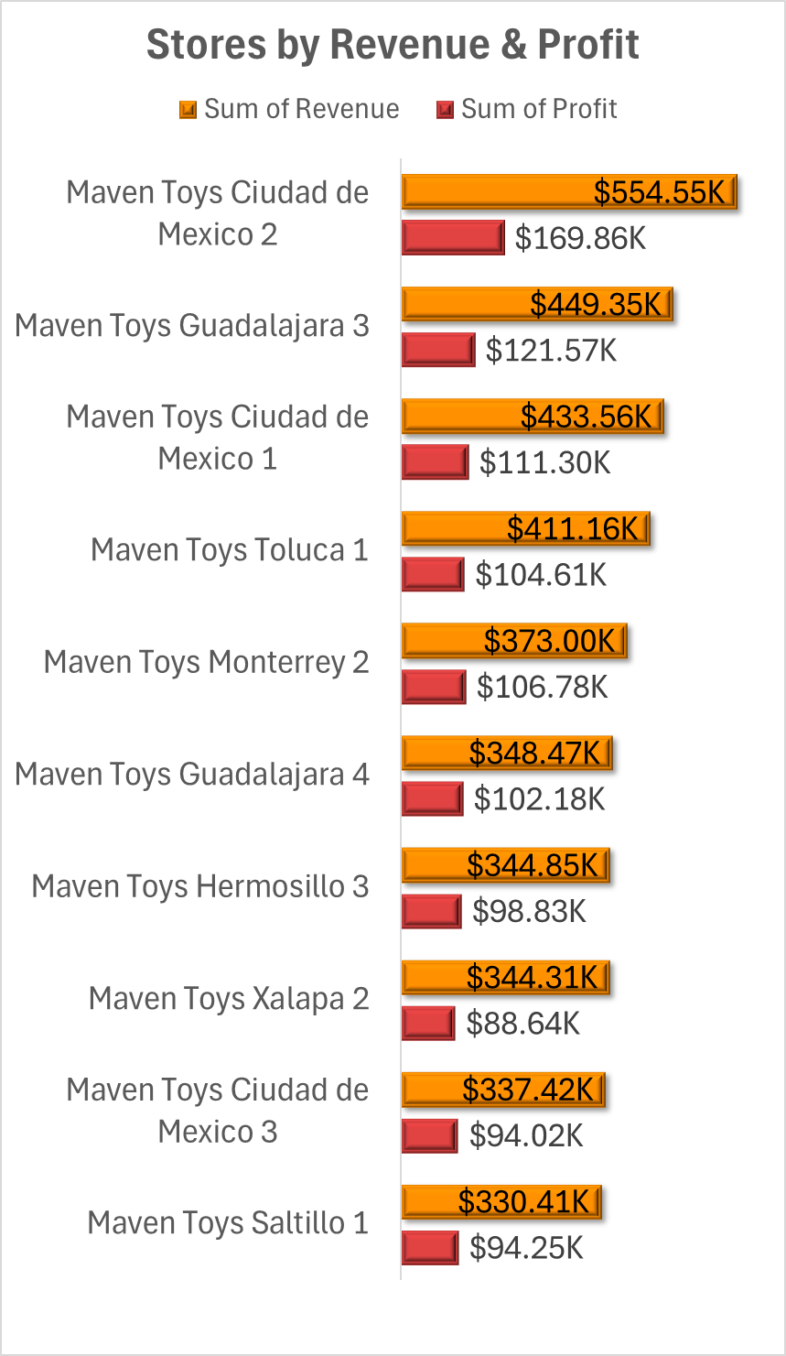
ANALYSIS & FINDINGS
Which stores generate the highest revenue and profit?
Finding:
  Top Revenue: Ciudad de Mexico 2 ($554.55K), Guadalajara 3 ($449.35K), Ciudad de Mexico 1 ($433.56K).
  Top Profit: Ciudad de Mexico 2 ($169.86K), Guadalajara 3 ($121.57K), Ciudad de Mexico 1 ($111.30K).
Insights
  Ciudad de Mexico 2 excels in revenue and profit, reflecting strong demand and efficient operations.
  Ciudad de Mexico and Guadalajara stores dominate, likely due to prime urban markets.
  Stores like Xalapa 2 and Ciudad de Mexico 3 have high revenue but lower profit, suggesting a need for pricing or cost-efficiency reviews.

Slide 27
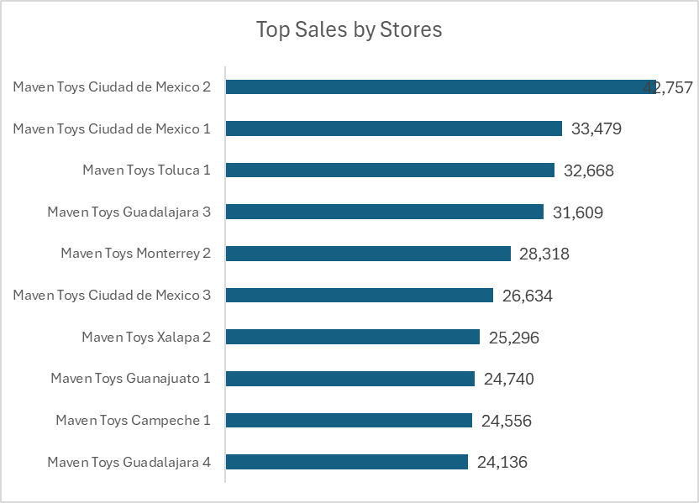
ANALYSIS & FINDINGS
Which stores sell the most products?
Finding:
Maven Toys Ciudad de Mexico 2 is the top-selling store with 42,757 products sold.
Other strong performers include Ciudad de Mexico 1 (33,479) and Toluca 1 (32,668).
Guadalajara 4 (24,136) records the lowest sales among listed stores.
Insight:
Ciudad de Mexico stores lead sales, driven by high customer traffic.
Performance varies within cities (e.g., Guadalajara 3 outperforms Guadalajara 4 by 7K+ units), likely due to location or management differences.
Replicate top stores' successful tactics in underperforming locations.

Slide 28
SUMMARY OF FINDINGS
Product Performance
Top Products and Categories:
Art & Crafts leads sales with 325,574 units, driven by PlayDoh, Slime, and Magic Sand. Electronics has the best-selling item, Colorbuds, but lower overall sales (134,075 units). Toys perform strongly (267,200 units) with Action Figures and Lego Bricks, while Games and Sports & Outdoors show moderate results.
Low Performers:
Games account for most low sellers, including Uno and Monopoly, with Mini Basketball Hoop being the weakest performer. Some Toys and Art & Crafts items, like Playfoam and PlayDoh Playset, also underperform due to low demand, poor visibility, or pricing issues.
Profitability:
Toys yield the highest profit ($1.08M), followed by Electronics ($1.00M, mainly from Colorbuds). Art & Crafts and Games earn moderate profits ($0.75M and $0.67M), while Sports & Outdoors trails ($0.51M). Low-profit products like Classic Dominoes and board games reflect weak margins or limited demand.
Inventory:
Products like Deck of Cards (2,738 units) and PlayDoh Can (2,129 units) show possible overstocking or seasonal mismatch. However, top stores such as Ciudad de Mexico 2 manage inventory efficiently, maintaining strong stock turnover.

Slide 29
SUMMARY OF FINDINGS
Sales Insights
Seasonality:
Sales peak in Q2 (April–June) and again in December, reflecting holiday and back-to-school demand. April records the highest sales (112,695 units), while October and November are the weakest months. Saturdays and Fridays drive the most sales, whereas Mondays and Tuesday's lag.
Store Performance:
Ciudad de Mexico 2 leads in performance (42,757 units, $554.55K revenue, $169.86K profit), followed by Ciudad de Mexico 1 and Guadalajara 3. Downtown stores dominate with 628,073 units sold, while Airport and Residential outlets underperform. Store age doesn’t guarantee success, as newer stores like Ciudad de Mexico 2 outperform older ones.
Location Impact:
Ciudad de Mexico, Guadalajara, and Monterrey record the highest sales, supported by dense populations and strong retail infrastructure. Lower-performing cities like Saltillo and Xalapa present opportunities for targeted growth.
Other Factors:
Top products such as Colorbuds and Action Figures benefit from brand strength and consistent demand. Pricing strategies appear to work well for profitable products, but low-margin items may require adjustment. Established stores in urban areas drive the majority of sales, while newer or less-visible locations continue to struggle.

Slide 30
RECOMMENDATIONS
Expand High-Performing Categories: Increase inventory and marketing for Art & Crafts and Toys, focusing on top sellers like PlayDoh, Slime, and Action Figures. Bundle Colorbuds with complementary products to boost Electronics sales.
Address Low Performers: Reassess Games and Sports & Outdoors offerings. Consider discontinuing or rebranding low sellers like Mini Basketball Hoop and Classic Dominoes. Investigate pricing, visibility, or stock issues for underperforming Toys and Art & Crafts products.
Optimize Inventory: Conduct a stock audit to address high inventory levels (e.g., Deck of Cards, PlayDoh Can). Improve demand forecasting to avoid overstock, especially for seasonal products.
Leverage Peak Seasons: Launch promotions in Q2 (April–June) and November–December to capitalize on high sales periods. Use clearance sales or targeted campaigns in low months like October and February.

Slide 31
RECOMMENDATIONS
Boost Weekend Sales: Increase staffing and promotions on Fridays and Saturdays. Introduce flash deals or events on Mondays and Tuesdays to lift early-week sales.
Focus on Top Locations: Replicate successful strategies from Ciudad de Mexico 2 and Downtown stores in underperforming locations like Airport and Residential areas. Enhance marketing or adjust product mix in low-sales cities like Saltillo and Xalapa.
Review Pricing and Costs: Analyze low-profit products for better pricing strategies or bundling. Investigate high-revenue, low-profit stores (e.g., Xalapa 2) for cost efficiencies to improve margins.

Slide 32
CONCLUSION
  It is clear from this analysis that the main drivers of sales and effective decision-making for growth and profitability in retail stores, as seen in this project, are product performance and pricing strategies. Prioritizing high-demand products within each category while targeting marketing efforts plays a major role in improving results. Other factors influencing retail sales include seasonal trends and geographical location. Additionally, identifying inefficiencies and poor sales turnover through inventory management is both essential and beneficial for sustaining profitability.

